Slide 1
KSA Stocks Analysis with Python
By Eman Al-Barkah
Top 5 bootcamp
18 Nov 2021

Slide 2
Outlines
Introduction
DATA
Data challenges
Design
Algorithm
Tools
Conclusion

Slide 3
Introduction
Everyone is interested in investing at Stock market nowadays
Everyone in the stock market has an opinion. I do, you do. Most of them are wrong or biased.
Stock Market investments give better returns as compared to gold.

Slide 4
Data
Getting Stock daily exchange data from Tadawul and saving it as excel in csv file
A total of 10,064 rows and 9 columns

Slide 5
Data Challenges
Transferring data from website into Excel file to save it as csv
Declutter data by dividing it into 4 csv files resulting in:
No NaN values
Visuals stands out more
Converting columns that contains commas into float by using function

Slide 6
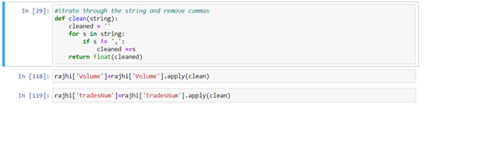
Data Challenges

Slide 7
Design
Question 1:
What stocks opining prices behavior over years?
Question 2:
Is there a correlation between stocks opening prices?
Question 3:
what is daily percentage change?
Question 4
What is the most traded stock Company?

Slide 8
Algorithms
Question 1:
What stocks opining prices behavior over years?

Slide 9
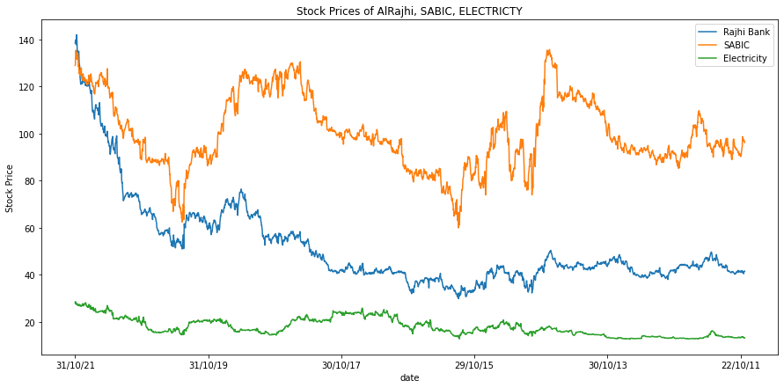
Algorithm

Slide 10
Algorithms
Question 2:
Is there a correlation between stocks opening prices?

Slide 11
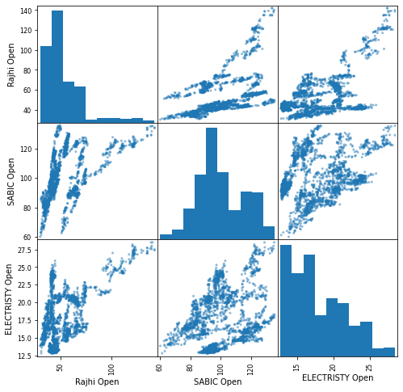
Algorithms

Slide 12
Algorithms
Question 3:
what is daily percentage change?

Slide 13
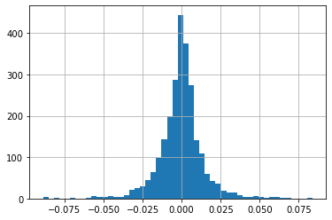
Algorithms

Slide 14
Algorithms
Question 4
What is the most traded stock Company?

Slide 15
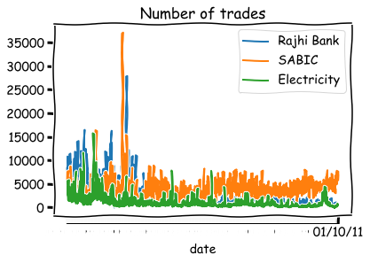
Algorithms

Slide 16






Tools

Slide 17
Conclusion
In conclusion my results will help investors to make the right decision in stocks market based on my exploratory data analysis.

Slide 18


